Slide 1
Relax and find the way
Dijkstra, A*, and a general overview.

Slide 2
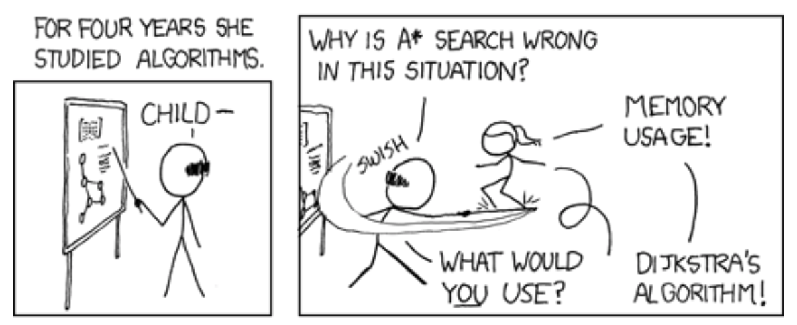
Dijkstra vs A*
Dijkstra’s algorithm and A* are very similar
We don’t have enough information at this moment to make a choice.
Generally in games we use A*

Slide 3


Pathfinding
We want to go from point A
To point B

Slide 4
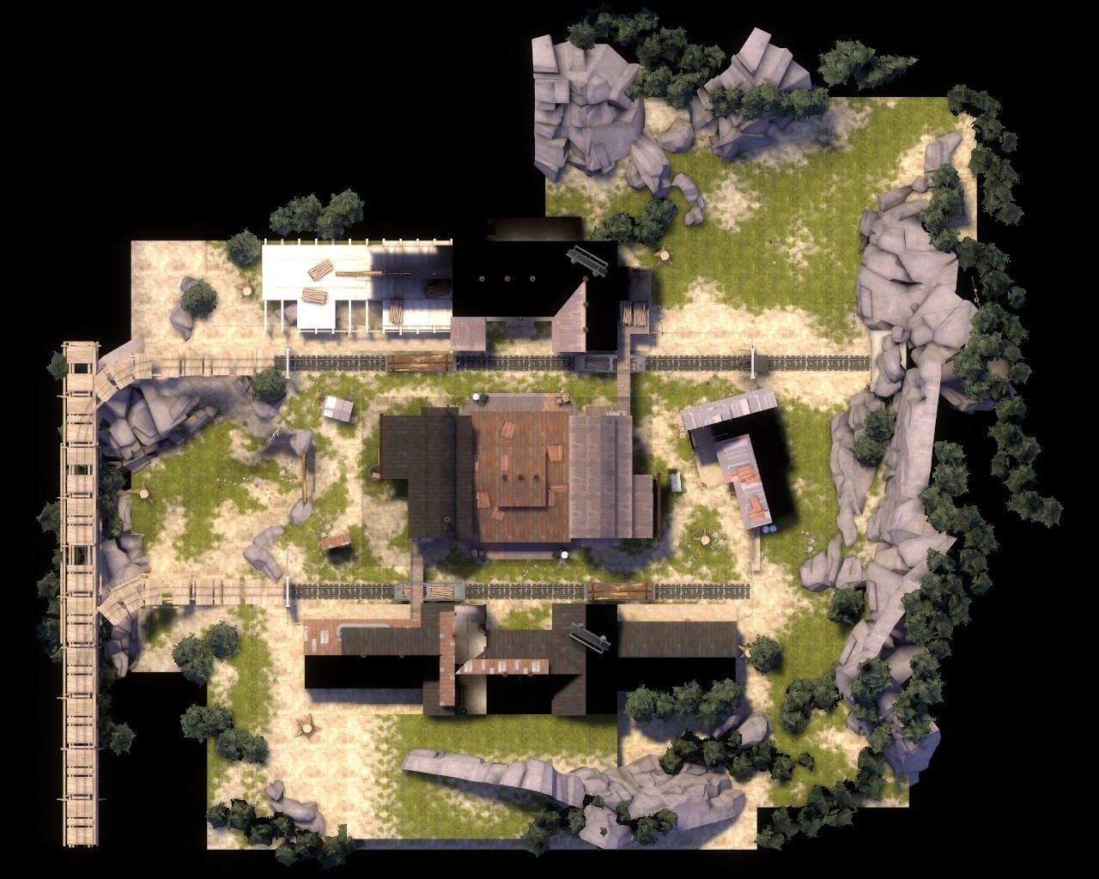
We want to go from point A to point B
We want to do this on a map.

Slide 5

We want to go from point A to point B
We want to do this on a map.
A
B

Slide 6
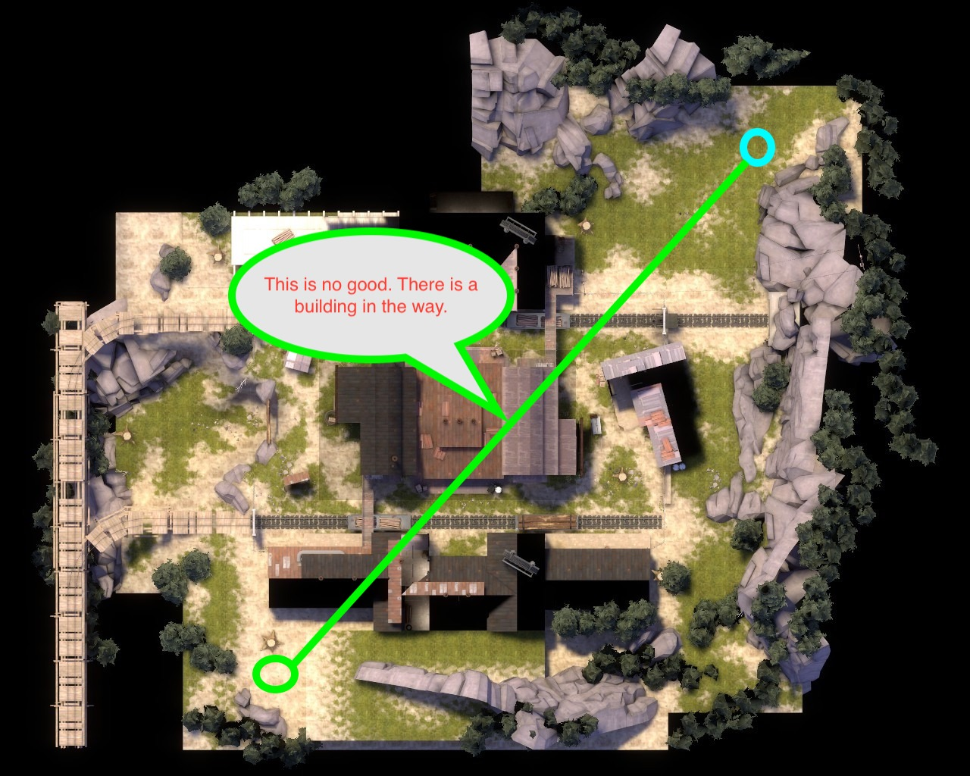
We want to do this on a map.
The shortest distance between two points is a line…
(I know we can go THROUGH the building but for now let's assume we can’t.)
A
B

Slide 7

The shortest distance between two points is a line…
We need other points…
A
P1
P2
B

Slide 8
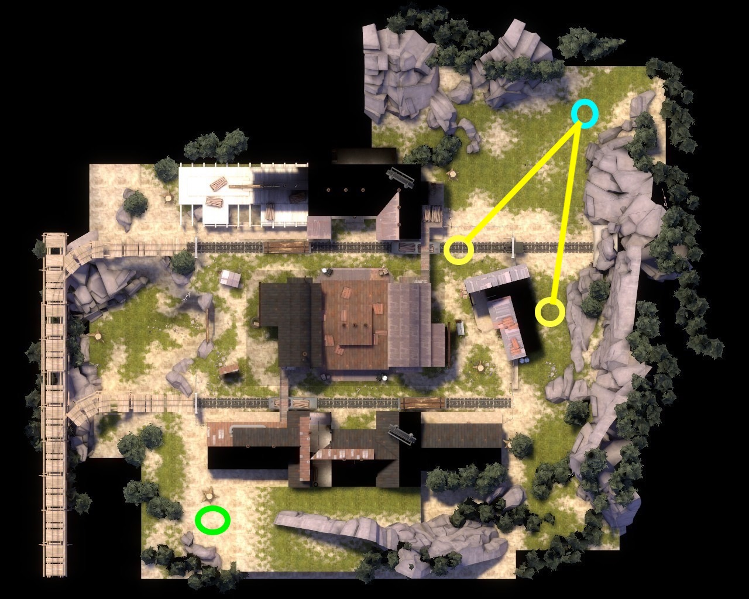
We need other points…
And other lines…

Slide 9
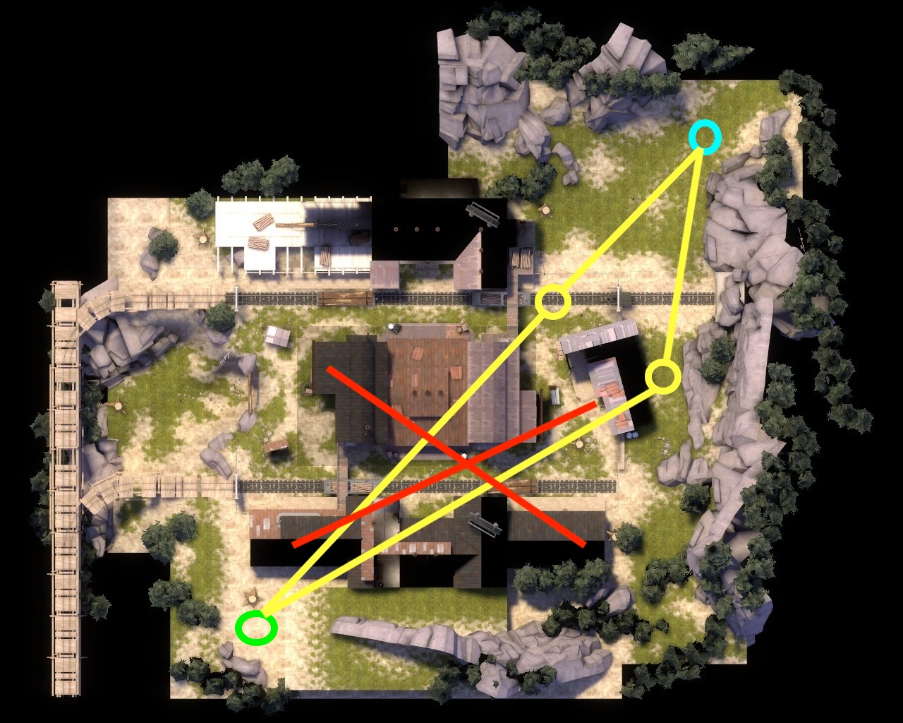
And other lines…
But now we are back to the first problem

Slide 10
But now we are back to the first problem
So let us get some MORE points

Slide 11

So let us get some MORE points
Now which path is the shortest?

Slide 13
Node

Slide 14
Node
Edge

Slide 15
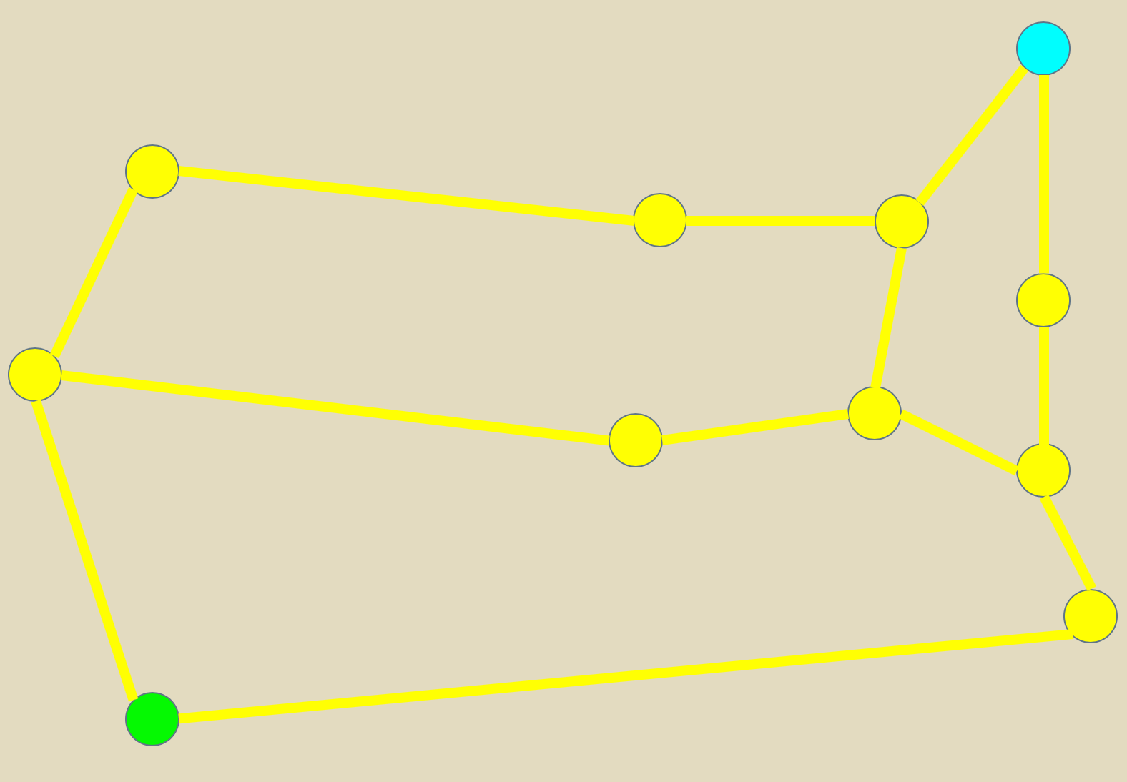
Node
Edge
Graph

Slide 16
Dijkstra’s Algorithm
Find the shortest path between nodes in a graph
Mark all nodes as unvisited
This is the unvisited set
Assign each node a distance value
Our initial node is 0, every other one is infinite
Calculate the distance between the current node, and all of its unvisited neighbors
If the new distance is less than the current distance change it
When all neighbors have been checked, move the current node to the visited set it will not be checked again
Stop when the destination is marked as visited OR when the smallest distance in the unvisited set is infinity
Set the unvisited node with the smallest tentative distance to the current node and go. Back to step 3

Slide 17
Dijkstra Step 1 and 2
Unvisited Set
Node | distance
n2 | ∞
n3 | ∞
n4 | ∞
n5 | ∞
n6 | ∞
n7 | ∞
n8 | ∞
n9 | ∞
n10 | ∞
n11 | ∞
Visited Set
Node | distance
Mark all nodes as unvisited
Assign each node a distance value
n1
0
n5
n4
n3
2
3
6
3
3
n9
2
n2
n8
n7
1
7
2
n6
5
4
1
n11
n10
10

Slide 18
Dijkstra Step 3
n1 → n3 0+2
n1 → n2 0+3
Unvisited Set
Node | distance
n2 | 3
n3 | 2
n4 | ∞
n5 | ∞
n6 | ∞
n7 | ∞
n8 | ∞
n9 | ∞
n10 | ∞
n11 | ∞
Visited Set
Node | distance
n1
0
n5
n4
n3
2
3
6
2
3
3
n9
2
3
n2
n8
n7
1
7
2
n6
5
4
1
Calculate the distance between the current node, and all of its unvisited neighbors
If the new distance is less than the current distance change it
n11
n10
10

Slide 19
Unvisited Set
Node | distance
n2 | 3
n3 | 2
n4 | 5
n5 | ∞
n6 | ∞
n7 | 4
n8 | ∞
n9 | ∞
n10 | ∞
n11 | ∞
Visited Set
Node | distance
n1 | 0
Dijkstra Step 3
n3 → n4 2+3
n3 → n7 2+2
n1
0
n5
n4
n3
2
3
6
5
2
3
3
n9
2
3
n2
n8
n7
1
4
7
2
n6
5
4
1
Calculate the distance between the current node, and all of its unvisited neighbors
If the new distance is less than the current distance change it
n11
n10
10

Slide 20
Unvisited Set
Node | distance
n2 | 3
n4 | 5
n5 | ∞
n6 | 4
n7 | 4
n8 | ∞
n9 | ∞
n10 | ∞
n11 | ∞
Visited Set
Node | distance
n1 | 0
n3 | 2
Dijkstra Step 3
n2 → n6 3+1
n1
0
n5
n4
n3
2
3
6
5
2
3
3
n9
2
3
n2
n8
n7
1
4
7
2
4
n6
5
4
1
Calculate the distance between the current node, and all of its unvisited neighbors
If the new distance is less than the current distance change it
n11
n10
10

Slide 21
Dijkstra Step 3
n6 → n7 4+2 > 4 (no change)
n6 → n10 4+1
Unvisited Set
Node | distance
n4 | 5
n5 | ∞
n6 | 4
n7 | 4
n8 | ∞
n9 | ∞
n10 | 5
n11 | ∞
Visited Set
Node | distance
n1 | 0
n3 | 2
n2 | 3
n1
0
n5
n4
n3
2
3
6
5
2
3
3
n9
2
3
n2
n8
n7
1
4
7
2
4
n6
5
4
1
5
Calculate the distance between the current node, and all of its unvisited neighbors
If the new distance is less than the current distance change it
n11
n10
10

Slide 22
Dijkstra Step 3
n7 → n8 4+4
Unvisited Set
Node | distance
n4 | 5
n5 | ∞
n7 | 4
n8 | 8
n9 | ∞
n10 | 5
n11 | ∞
Visited Set
Node | distance
n1 | 0
n3 | 2
n2 | 3
n6 | 4
n1
0
n5
n4
n3
2
3
6
5
2
3
3
n9
2
3
n2
n8
n7
1
4
7
8
n6
5
4
2
4
1
5
n11
n10
10

Slide 23
Dijkstra Step 3
n4 → n5 5+6
Unvisited Set
Node | distance
n4 | 5
n5 | 11
n8 | 8
n9 | ∞
n10 | 5
n11 | ∞
Visited Set
Node | distance
n1 | 0
n3 | 2
n2 | 3
n6 | 4
n7 | 4
n1
0
n5
n4
n3
11
2
3
6
5
2
3
3
n9
2
3
n2
n8
n7
1
4
7
8
n6
5
4
2
4
1
5
Calculate the distance between the current node, and all of its unvisited neighbors
If the new distance is less than the current distance change it
n11
n10
10

Slide 24
Dijkstra Step 3
n10 → n11 5+10
Unvisited Set
Node | distance
n5 | 11
N8 | 8
n9 | ∞
n10 | 5
n11 | 15
Visited Set
Node | distance
n1 | 0
n3 | 2
n2 | 3
n6 | 4
n7 | 4
n4 | 5
n1
0
n5
n4
n3
11
2
3
6
5
2
3
3
n9
2
3
n2
n8
n7
1
Done!
Path is n1→ n2 → n6 → n10 → n11
4
7
8
n6
5
4
2
4
1
Stop when the destination is marked as visited OR when the smallest distance in the unvisited set is infinity
5
n11
n10
15
10

Slide 25
Dijkstra’s Algorithm
Find the shortest path between nodes in a graph
Mark all nodes as unvisited
This is the unvisited set
Assign each node a distance value
Our initial node is 0, every other one is infinite
Calculate the distance between the current node, and all of it’s unvisited neighbors
If the new distance is less than the current distance change it
When all neighbors have been checked, move the current node to the visited set it will not be checked again
Stop when the destination is marked as visited OR when the smallest distance in the unvisited set is infinity
Set the unvisited node with the smallest tentative distance to the current node and go. Back to step 3

Slide 26
Dijkstra Step 1 and 2
Unvisited Set
Node | distance
n11 | ∞
Visited Set
Node | distance
n1
0
n5
n4
n3
Stop when the destination is marked as visited OR when the smallest distance in the unvisited set is infinity
2
3
6
3
3
n9
2
n2
n8
n7
1
7
4
2
n6
1
5
n11
n10

Slide 27
If a new distance is CLOSER
If an edge distance calculation results in smaller value…

Slide 28
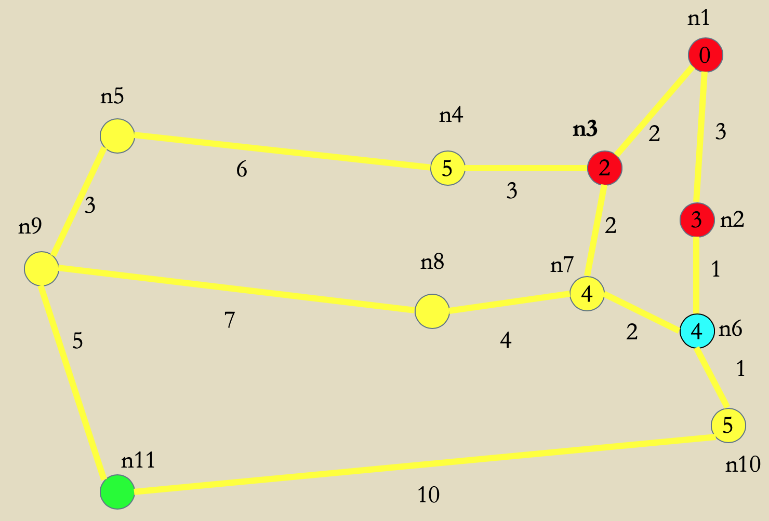
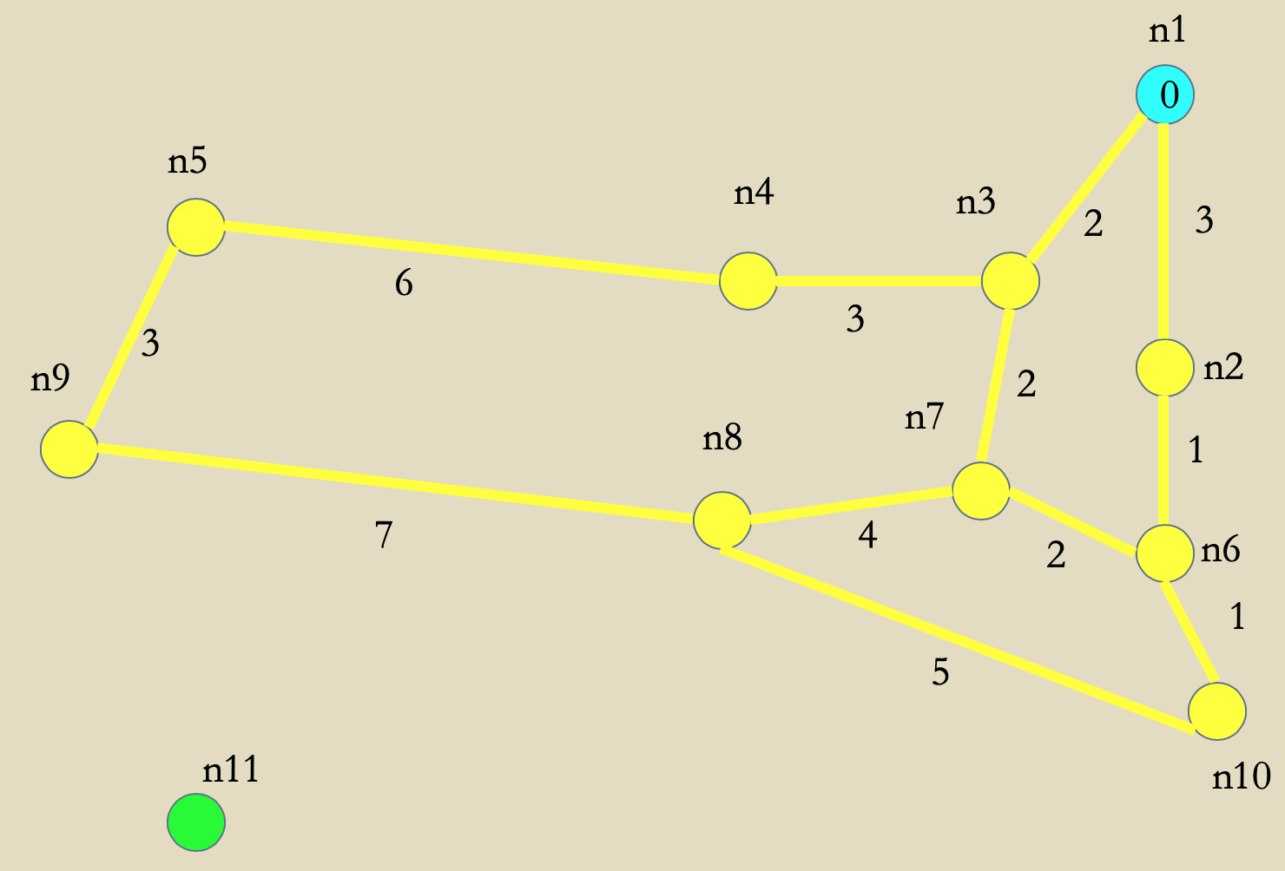
Old ➔ New
If a new distance is CLOSER
If an edge distance calculation results in smaller value…

Slide 29
Dijkstra Step 3
n6 → n7 4+2 > 4 (no change)
n6 → n10 4+1
Unvisited Set
Node | distance
n4 | 5
n5 | ∞
n6 | 4
n7 | 4
n8 | ∞
n9 | ∞
n10 | 5
n11 | ∞
Visited Set
Node | distance
n1 | 0
n3 | 2
n2 | 3
n1
0
n5
n4
n3
2
3
6
5
2
3
3
n9
2
3
n2
n8
n7
1
4
7
2
4
n6
5
4
1
5
n11
n10
10

Slide 30
IF A NEW DISTANCE IS CLOSER
n6 → n7 4+1 < 6 so now the value changes
Unvisited Set
Node | distance
n4 | 5
n5 | ∞
n6 | 4
n7 | 6
n8 | ∞
n9 | ∞
n10 | 5
n11 | ∞
Visited Set
Node | distance
n1 | 0
n3 | 2
n2 | 3
n1
0
n5
n4
n3
3
3
6
5
3
3
3
n9
3
3
n2
n8
n7
1
6
7
1
4
n6
5
4
1
5
n11
n10
10

Slide 31
IF A NEW DISTANCE IS CLOSER
n6 → n7 4+1 < 6 so now the value changes
Unvisited Set
Node | distance
n4 | 5
n5 | ∞
n6 | 4
n7 | 5
n8 | ∞
n9 | ∞
n10 | 5
n11 | ∞
Visited Set
Node | distance
n1 | 0
n3 | 2
n2 | 3
n1
0
n5
n4
n3
3
3
6
5
3
3
3
n9
3
3
n2
n8
n7
1
5
7
1
4
n6
5
4
1
5
n11
n10
10

Slide 32
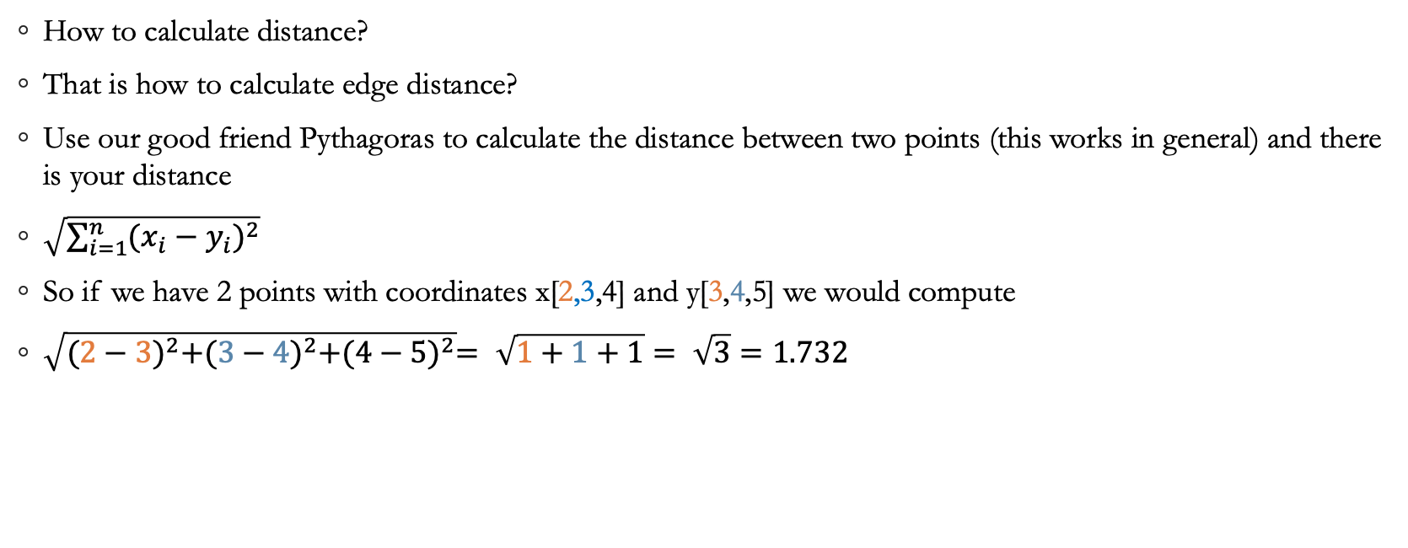
Challenge
How to calculate distance?
That is how to calculate edge distance?
Use our good friend Pythagoras to calculate the distance between two points (this works in general) and there is your distance
$\sqrt{\sum_{i=1}^{n}{{(x_{i}−y_{i})}^{2}}}$
So if we have 2 points with coordinates x[2,3,4] and y[3,4,5] we would compute
$\sqrt{{(2−3)}^{2}+{(3−4)}^{2}+{(4−5)}^{2}}= \sqrt{1+1+1}= \sqrt{3}=1.732$

Slide 33
But distance isn’t the only issue
How much does it cost to get there?
If it is a straight line but we need to jump a fence and destroy a wall it costs more than a more circuitous route.
Find some heuristic to calculate how much it costs to get there
Maybe if we use the command pattern, we can figure how many commands it takes?
Maybe add a cost to barriers in the form of an arbitrary distance constant?
(i.e. breaking a wall costs 3, a block to jump costs 2, etc.)

Slide 34
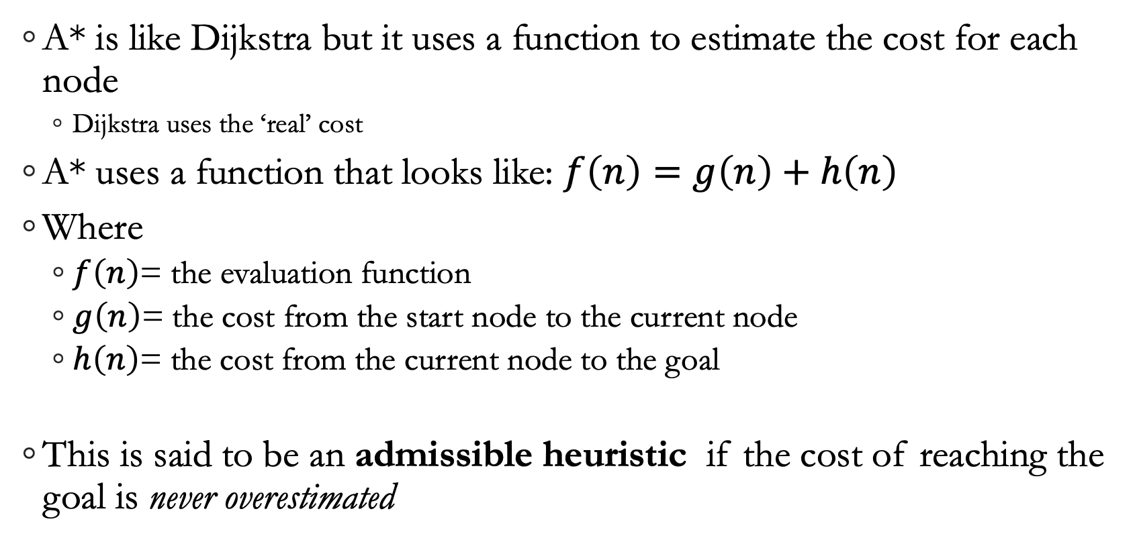
A* vs Dijkstra
A* is like Dijkstra but it uses a function to estimate the cost for each node
Dijkstra uses the ‘real’ cost
A* uses a function that looks like: $f\left(n\right)=g\left(n\right)+h\left(n\right)$
Where
$f\left(n\right)$= the evaluation function
$g\left(n\right)$= the cost from the start node to the current node
$h\left(n\right)$= the cost from the current node to the goal
This is said to be an admissible heuristic if the cost of reaching the goal is never overestimated

Slide 35
Time to relax
A*, and really any path finding algorithm, uses something called relaxation
Essentially, the algorithm is modified to return a sub-optimal path by eliminating some of the nodes before they are checked.
we could check the distance and cost and, if one node gets use closer, then we don’t bother checking any others.
Basically for any vertex we can reach, calculate distance to target
Pick which ever one is closer to the target and proceed.
Can be tuned i.e. if our next step isn’t closer, or if goal isn’t reached in x steps…

Slide 36
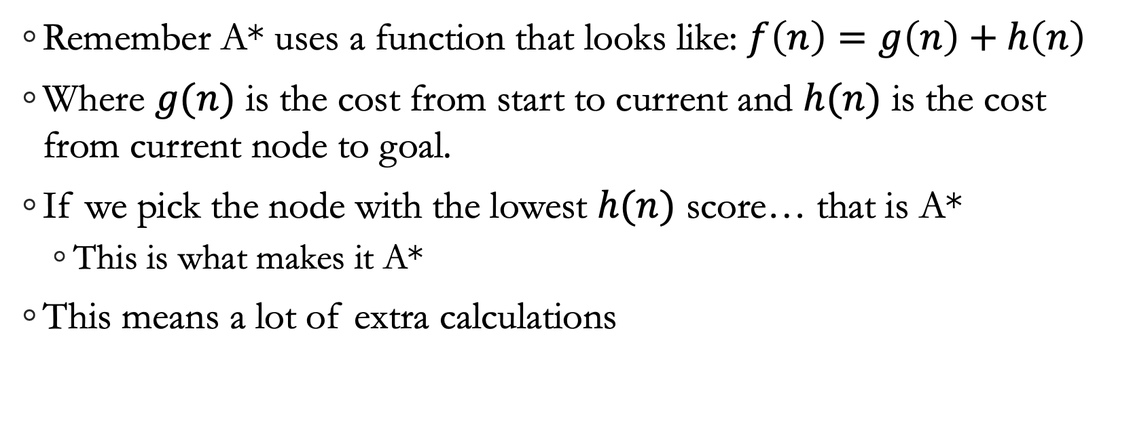
Frankie says: Relax Don’t Do It
Remember A* uses a function that looks like: $f\left(n\right)=g\left(n\right)+h\left(n\right)$
Where $g(n)$ is the cost from start to current and $h(n)$ is the cost from current node to goal.
If we pick the node with the lowest $h(n)$ score… that is A*
This is what makes it A*
This means a lot of extra calculations

Slide 37
Quick and sub optimal
n1
n5
n4
n3
2
3
6
3
3
n9
2
n2
n8
n7
1
7
2
n6
5
4
1
n11
n10
10

Slide 38
Quick and sub optimal
n1
n5
n4
n3
2
3
6
3
3
n9
2
n2
n8
n7
1
7
2
n6
5
4
1
n11
n10
10

Slide 39
Quick and sub optimal
n1
n5
n4
n3
2
3
6
3
3
n9
2
n2
n8
n7
1
7
2
n6
5
4
1
n11
n10
10

Slide 40
Quick and sub optimal
n1
n5
n4
n3
2
3
6
3
3
n9
2
n2
n8
n7
1
7
2
n6
5
4
1
n11
n10
10

Slide 41
Quick and sub optimal
n1
n5
n4
n3
2
3
6
3
3
n9
2
n2
n8
n7
1
7
2
n6
5
4
1
n11
n10
10

Slide 42
Quick and sub optimal
n1
n5
n4
n3
2
3
6
3
3
n9
2
n2
n8
n7
1
7
2
n6
5
4
1
n11
n10
10

Slide 43
Quick and sub optimal
n1
n5
n4
n3
2
3
6
3
3
n9
2
n2
n8
n7
1
7
2
n6
5
4
1
n11
n10
10

Slide 44

A* Takes more memory (stores more path data and does more computations)
Dijkstra's takes longer but is cheaper
also takes longer to say

Slide 45
Pathfinding, now with navmesh!
First decide on a simple navmesh layout
Valve uses rectangles because they are quick
One recommended technique is to use triangles

Slide 46
Pathfinding, now with navmesh!
First decide on a simple navmesh layout
Valve uses rectangles as this is quick
One recommended technique is to use triangles
Because triangles are more flexible, and the math isn't that much harder

Slide 47
Pathfinding, now with navmesh!
First decide on a simple navmesh layout
Valve uses rectangles as this is quick
One recommended technique is to use triangles
One important rule: no concave shapes
Why is this?

Slide 48
DEFINITION: concave and convex
concave adjective
having an outline or surface that curves inward like the interior of a circle or sphere: concave lenses.
curved inwards, hollow, hollowed out, scooped out, depressed, sunken; indented, recessed; rare incurved, incurvate.
convex adjective
having an outline or surface curved like the exterior of a circle or sphere: a convex lens.
(of a polygon) having only interior angles measuring less than 180°.

Slide 49
Pathfinding, now with navmesh!
First decide on a simple navmesh layout
Valve uses rectangles as this is quick
One recommended technique is to use triangles
One important rule: no concave shapes
Why is this?

Slide 50
Pathfinding, now with navmesh!
First decide on a simple navmesh layout
Valve uses rectangles as this is quick
One recommended technique is to use triangles
One important rule: no concave shapes
Anyone know why?

Slide 51
Benefits of being a triangle
If our vertices are coincident then we don’t need a list of of connections
Because every triangle is connected to every other triangle, each one shares a vertex so look for the triangle with a shared point and you’re good.
Typically we aren’t going to be on an edge
This means we need to figure out which triangle we are in
Use cross products it is fast, and most languages have built in functions
http://blackpawn.com/texts/pointinpoly/default.html
Another way https://jsfiddle.net/PerroAZUL/zdaY8/1/

Slide 52
DEFENITION: Coincident
coincident adjective
occurring together in space or time

Slide 53
Benefits of being a triangle
If our vertices are coincident then we don’t need a list of of connections
Because every triangle is connected to every other triangle, each one shares a vertex so look for the triangle with a shared point and you’re good.
Typically we aren’t going to be on an edge
This means we need to figure out which triangle we are in
How: cross products
fast, and most languages have built in functions
http://blackpawn.com/texts/pointinpoly/default.html
Another way https://jsfiddle.net/PerroAZUL/zdaY8/1/

Slide 54
RULES!
Both points on the same triangle
GREAT! Straight line.

Slide 55
RULES!
Both points on the same triangle
One or both outside all triangles
One or both aren’t in the navmesh.
Stop calculating and return null, no path possible

Slide 56
RULES!
Both points on the same triangle
One or both outside all triangles
Both points are on different triangles
Carry on (my wayward son!)

Slide 57
Once we have a start and end point…
Now we calculate how to go from our position to a vertex

Slide 58
Then from each vertex to the next
Now we calculate how to go from our position to a vertex
It would be convenient to have a method to determine which vertex is closest to our goal…

Slide 59
Once we reach our goal triangle..
Calculate vertex to point
Back trace…

Slide 60
Once we reach our goal triangle..
Calculate vertex to point
Back trace…
We have our path.

Slide 61
Adding points to get MORE triangles (let’s assume that each line is straight)
If there is an obstacle the cost goes up to ∞ and doesn’t drop.

Slide 62
Smaller triangles means better paths but more costly calculations

Slide 63
Some thoughts on efficiency
How often should we re-calculate?
That is, how often should we find a new path?
How FAR should we calculate?
If we can determine which triangle is closest to our goal maybe navigate there and then recalculate?
This way it is always straight lines…
Perhaps use an observer model to post locations of goals…

Slide 64
Some Additional Information
A video and some resources
https://www.youtube.com/watch?v=QJHPlr582do
Read this: https://www.redblobgames.com/pathfinding/a-star/introduction.html
This is a GREAT introduction to A* etc
Implementing with NavMeshs https://medium.com/@mscansian/a-with-navigation-meshes-246fd9e72424
Implementing A* in C++ and C# https://github.com/justinhj/astar-algorithm-cpp
A different implementation https://www.nielsvandermolen.com/how-to-implement-custom-pathfinding-a-cc-in-unreal-engine-4/

